Slide 1
IDX R1 Entities and Entitlements
Solution Architecture
P2054 – Industry Data Exchange

Slide 2
IDX Release 1 Capabilities,
PQD Business Function and Entities
The BPQD API and all other IDX services (e.g. Transaction Logging) will use URM/MSATS for all entitlements and permissions.
These entitlements in URM will allow participants to use API and User Interfaces from IDX.
Permissions within those entitlements will allow varying levels of access to BPQD API and the IDX services.
The following slides outline the BPQD and the IDX services which will be available in Release-1.
Using the UI
All IDX WebApps will be on the Markets Portal. Entitlements and permissions can be created and granted to users in URM. The following slides will outline the entity names and what the permissions allow access to.
Using the APIs
All IDX WebApp capabilities are also available as APIs, and BPQD itself is an API.
Entitlements and permissions can be created and granted to machine-accounts as users in URM.

Slide 3
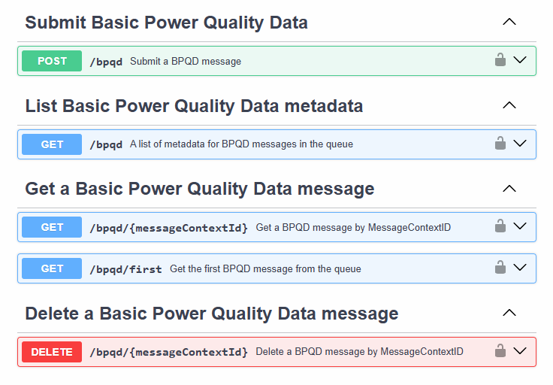
BPQD
Entity Name: | PQD_BPQD
URM Permission
API Endpoint
CREATE
READ
DELETE
NOTE: In URM, when Update is assigned it inherits Read, when Create is assigned it inherits Update and Read and when Delete is assigned it inherits Create, Update and Read.

Slide 4
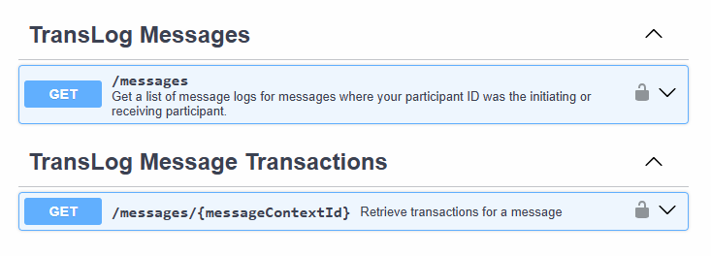
Transaction Logging
Entity Name: | TRANSLOG_TRANSLOG
URM Permission
API Endpoint
READ
NOTE: In URM, when Update is assigned it inherits Read, when Create is assigned it inherits Update and Read and when Delete is assigned it inherits Create, Update and Read.

Slide 5
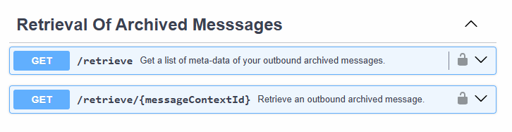
Archive
Entity Name: | ARCH_RETRIEVE
URM Permission
API Endpoint
READ
NOTE: In URM, when Update is assigned it inherits Read, when Create is assigned it inherits Update and Read and when Delete is assigned it inherits Create, Update and Read.

Slide 6
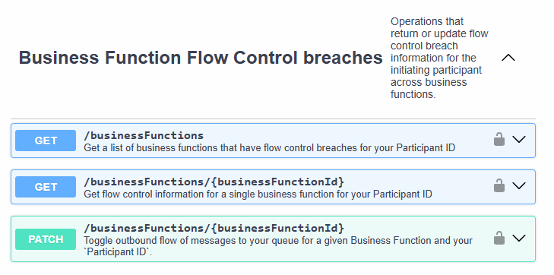
Flow Control
Entity Name: | FCTRL_FCTRL
URM Permission
API Endpoint
READ
CREATE
NOTE: In URM, when Update is assigned it inherits Read, when Create is assigned it inherits Update and Read and when Delete is assigned it inherits Create, Update and Read.

Slide 7
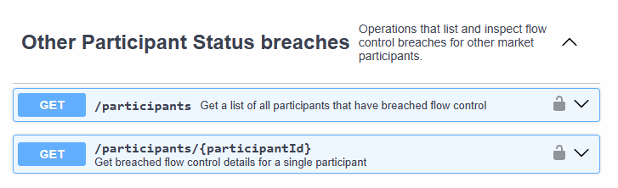
Participant Status
Entity Name: | FCTRL_STATUS
URM Permission
API Endpoint
READ
NOTE: In URM, when Update is assigned it inherits Read, when Create is assigned it inherits Update and Read and when Delete is assigned it inherits Create, Update and Read.

Slide 8

Event Notification
Entity Name: | EVENT_NOTIFY
URM Permission
API Endpoint
READ
NOTE: In URM, when Update is assigned it inherits Read, when Create is assigned it inherits Update and Read and when Delete is assigned it inherits Create, Update and Read.
NOTE2: The EVENT_NOTIFY scope will allow clients to open a WSS connection to the API, however additional scope are required to receive events; PQD_BPQD scope is required to receive BPQD events, and FCTRL_STATUS is required to receive flow control events.

